Slide 1
Unit 10 For Live Session Assignment
Isabella Westlauer
3/9/2026

Slide 2

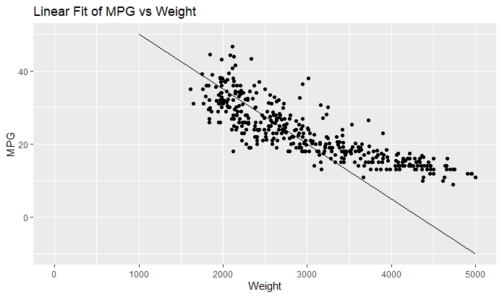

Fit the model $mpg= β_{0}+β_{1}Weight+ ε$
This plot shows that a straight line is not a good fit for the data. We need to add another dimension.
Try: MPG = 65 -0.015*Weight + (eta)
Fit: MPG = 46.2734 – 0.0076613*Weight + (eta)
Notes:
Using the cars.csv dataset,
Fit the model $mpg= β_{0}+β_{1}Weight+ ε$
Conduct a 6 step hypothesis test of the slope. That is, test the claim that the slope is significantly different from zero. Show all 6 steps and quantify your uncertainty by including a 95% confidence interval for the slope.
Describe the relationship between miles per gallon and the weight of the car by interpreting the slope parameter. Again, be sure and include a 95% confidence interval in your interpretation.

Slide 3
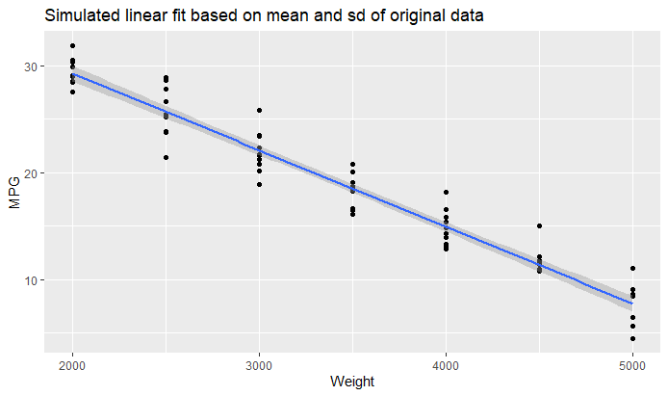
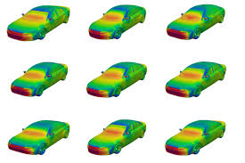
Fit the model $mpg= β_{0}+β_{1}Weight+ ε$
Fit: MPG = 46.2734 – 0.0076613*Weight + (eta)
This plot shows a linear fit based on simulated data, produced by generating mpg for 7 weights based on the mean and sd at those weights.
Notes:
Using the cars.csv dataset,
Fit the model $mpg= β_{0}+β_{1}Weight+ ε$
Conduct a 6 step hypothesis test of the slope. That is, test the claim that the slope is significantly different from zero. Show all 6 steps and quantify your uncertainty by including a 95% confidence interval for the slope.
Describe the relationship between miles per gallon and the weight of the car by interpreting the slope parameter. Again, be sure and include a 95% confidence interval in your interpretation.

Slide 4

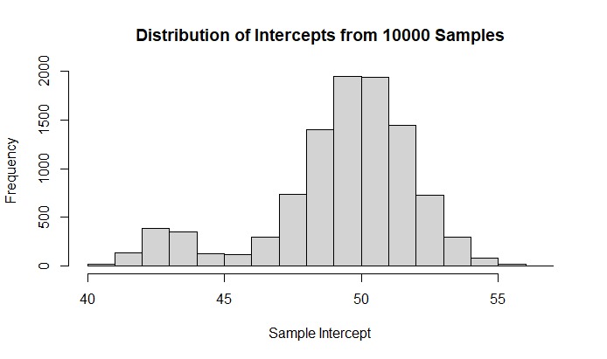
Fit the model $mpg= β_{0}+β_{1}Weight+ ε$
This plot shows the distribution of intercepts from generating samples and finding the fit 10,000 times.
 | Intercept | Slope
Tstat | 58.02322 | -29.72953
Pvalue | 6.313417e-194 | 2.785334e-102
Notes:
Using the cars.csv dataset,
Fit the model $mpg= β_{0}+β_{1}Weight+ ε$
Conduct a 6 step hypothesis test of the slope. That is, test the claim that the slope is significantly different from zero. Show all 6 steps and quantify your uncertainty by including a 95% confidence interval for the slope.
Describe the relationship between miles per gallon and the weight of the car by interpreting the slope parameter. Again, be sure and include a 95% confidence interval in your interpretation.

Slide 5

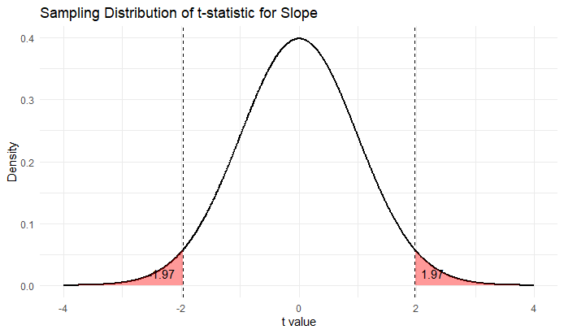

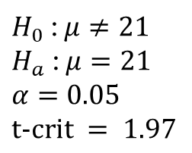
Test the claim that the slope is significantly different from zero.
Step 1: hypotheses
Step 2: draw and shade and find the critical value
$H_{0}$ : $μ≠21$
$H_{a}$ : $μ=21$
$$α=0.05$$
$$t-crit = 1.97$$
Null hypothesis: there is no relationship between the predictor and the outcome, or weight and mpg have no relationship
Alternative hypothesis: weight and mpg are related
Confidence Interval: 0.05, the hypothesis we accept from this test will have a 95% confidence
Notes:
Conduct a 6 step hypothesis test of the slope. That is, test the claim that the slope is significantly different from zero. Show all 6 steps and quantify your uncertainty by including a 95% confidence interval for the slope.

Slide 6

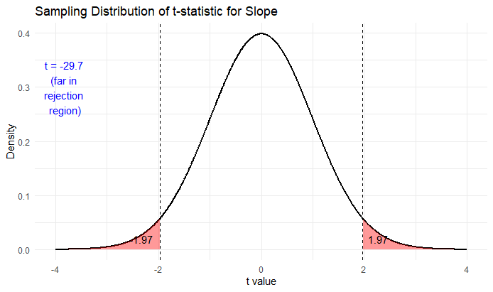


Test the claim that the slope is significantly different from zero.
Step 3: find the t-statistic
Step 4: find the p-value
 | Slope | Meaning
Tstat | -29.72953 | My estimate is about 30 standard errors away from 0.
Pvalue | 2.785334e-102 | If the slope were really 0, how likely would it be to see a t-stat this extreme? Almost impossible.
Notes:
Conduct a 6 step hypothesis test of the slope. That is, test the claim that the slope is significantly different from zero. Show all 6 steps and quantify your uncertainty by including a 95% confidence interval for the slope.

Slide 7
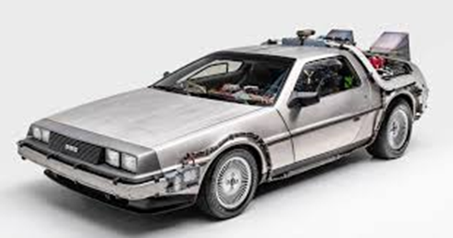
Test the claim that the slope is significantly different from zero.
Step 5: Decision
Step 6: Conclusion
I decide to reject the null hypothesis, because the likelihood is almost impossible.
The observed test statistic is far in the reject region, meaning that it is very unlikely the weight and mpg of cars are unrelated.
That means the weight and mpg are very likely related and the slope is not 0!

Slide 8

Describe the relationship between miles per gallon and the weight of the car by interpreting the slope parameter. Again, be sure and include a 95% confidence interval in your interpretation.
For each 1000 pound increase in vehicle weight, the average MPG decreases by 7.6!
A 95% confidence interval for the slope is approximately −0.00817 to −0.00715.
This means we are 95% confident that the true decrease in MPG per additional pound of weight lies between 0.00715 and 0.00817 MPG (or between 7.15 and 8.17 MPG per 1000 pounds).
Because the entire confidence interval is negative, this provides strong evidence that heavier cars tend to have lower fuel efficiency.

Slide 9
Internal n-fold (leave one out) cross validation of SLR models

Slide 10

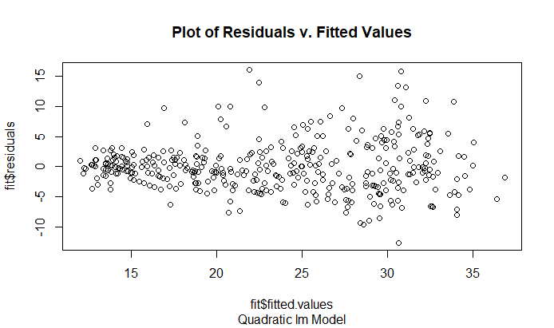
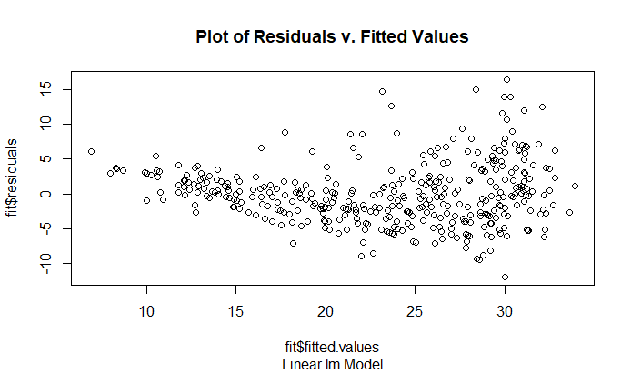
The distribution of residuals should be normal and have constant variance for fixed values of the explanatory variable(s)
How do these plots show normal distribution or constant variance? Can I use this type of plot to check if the assumptions of MLR are being met?

Slide 11
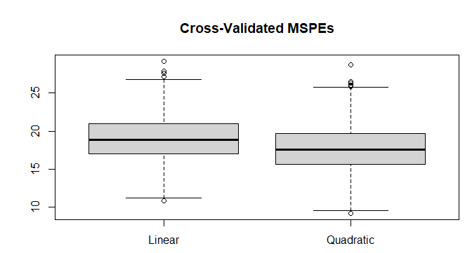

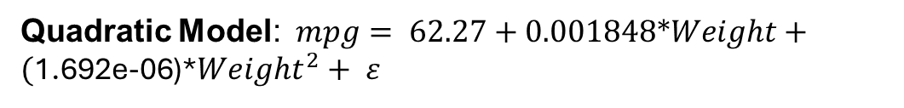
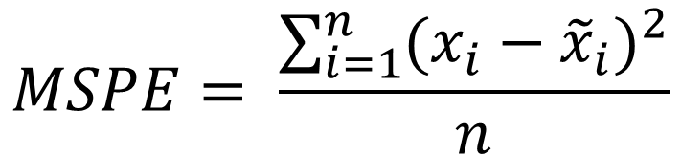

Linear Model : $mpg= β_{0}+β_{1}Weight+ε$
Quadratic Model: $mpg= 62.27+0.001848*Weight+(\text{1.692}\text{e}\text{-06}$)*${Weight}^{2}+ ε$
$$MSPE= \frac{\sum_{i=1}^{n}{{(x_{i}−{\tilde{x}}_{i})}^{2}}}{n}$$
I did a 1000-fold cross validation of both the SLR models, and the quadratic model has the lower mean MSPE.
 | Linear | Quadratic
Mean MSPE | 19.03893 | 17.72538
The quadratic model has lower mean MSPE, so it is favorable compared to the linear model.
Notes:
2. Using the cars.csv, conduct an internal n-fold (leave one out) cross validation of the following SLR models:
Model 1: $mpg= β_{0}+β_{1}Weight+ε$
Model 2: $mpg= β_{0}+β_{1}Weight+β_{2}{Weight}^{2}+ ε$
Which model is favored by this cross validation?
Describe the relationship between miles per gallon and the weight of the car (if it has changed) (again making sure to quantify any uncertainty you may have.)
Use the favored model to estimate the mean mpg of cars that weigh 2000 lbs.

Slide 12

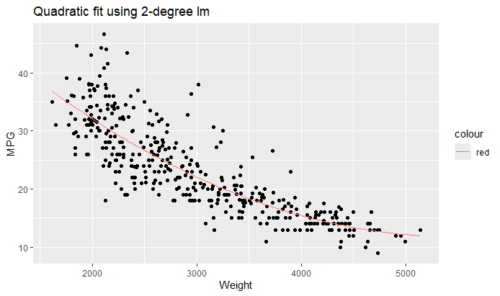

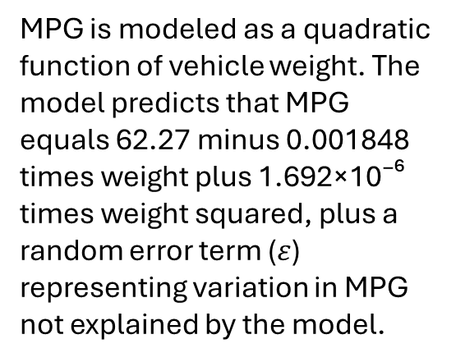
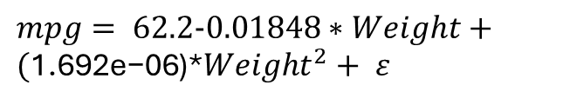
If the weight of the car is 2000 lbs, the mean mpg is estimated to be 32.078, with a 97.5% confidence interval, meaning there may be some error term that the model does not account for.
MPG is modeled as a quadratic function of vehicle weight. The model predicts that MPG equals 62.27 minus 0.001848 times weight plus 1.692×10⁻⁶ times weight squared, plus a random error term ($ε$) representing variation in MPG not explained by the model.
$mpg= 62.2-0.01848∗Weight+(\text{1.692}\text{e}\text{−06}$)*${Weight}^{2}+ ε$
Notes:
Describe the relationship between miles per gallon and the weight of the car (if it has changed) (again making sure to quantify any uncertainty you may have.)

Slide 13
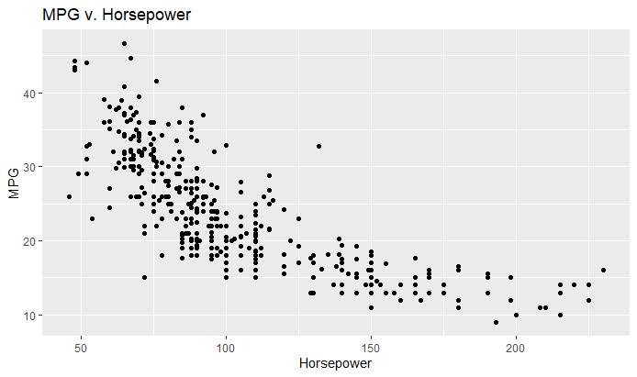

Impute missing horsepower values by fitting a linear regression model
I trained a model by splitting the data into not missing HP (training set) and missing HP (test set) with Weight and Displacement as predictors “regressors”.
Then I replaced the 2 missing values with the predicted values.
The relationship between the mpg and the horsepower seems to have a curve similar to the MPG v. Weight. Maybe the horsepower and weight are correlated?
I will use a quadratic model again for this one.
Notes:
3. Using the cars.csv dataset, We would like to assess the relationship (interpret slope parameter) between mpg and horsepower. Notice that some of the horsepowers are missing.
Impute (predict and insert) the missing horsepowers by fitting a regression model.
You may use any of the variables as regressors EXCEPT for mpg (since we will later be using horsepower to predict mpg.)
Assess the relationship between the mpg and the horsepower. Make sure and include estimates of your uncertainty (ie. Confidence intervals.)
Use your model and imputed data to estimate the mean mpg for a car with 250 horsepower.

Slide 14
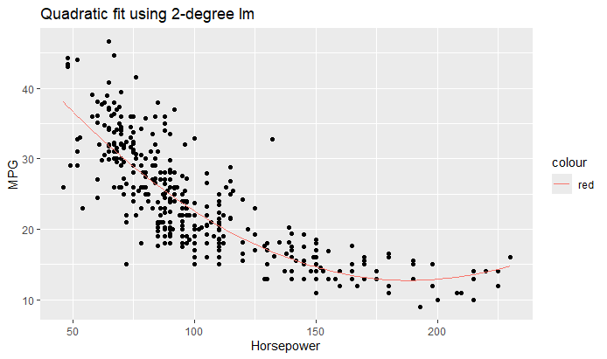



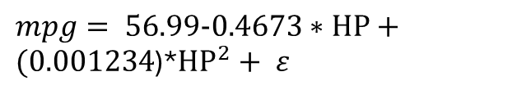
Estimated mean mpg for a car with 250 horsepower: 17.29, with a 97.5% confidence interval.
$mpg= 56.99-0.4673∗HP+(\text{0.001234}$)*${HP}^{2}+ ε$

Slide 15
Takeaways and Questions
The t-statistic tells you:
How strong the evidence is that a coefficient is not zero.
The p-value tells you:
How surprising the data would be if the coefficient were actually zero.
I’m not sure about the confidence interval. I know there’s some error term in the linear regression equation. But, how do I know if the fit is correct with a 95% probability? Is that why we did the t-test?

